Slide 2
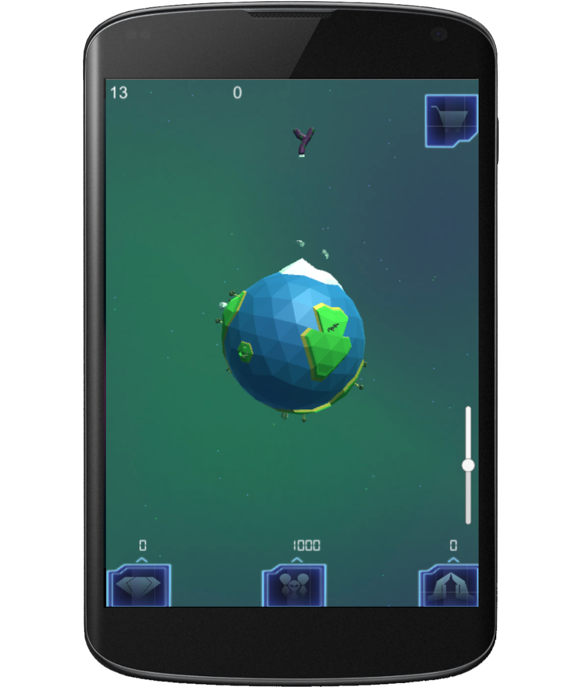

Slide 3
First the player is presented with their planet core

Slide 4

The player is shown the wealth of the planet
This is the mineral wealth of your planet
0

Slide 5

Players are introduced to asteroids
Throw the asteroid into the planet core
0

Slide 6
Players is shown how asteroids increase the planet wealth
The asteroid’s minerals increase the wealth of the planet
20

Slide 7
Players repeat the asteroid throw
Increase the wealth of your planet again
20

Slide 8
Player planet grows
The planet grows, and life begins
40

Slide 9
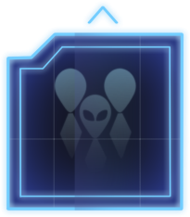
Player introduced to population
The population of your planet is displayed here Every minute it will grow
40
100

Slide 10

Player introduced to faith
This is your planets faith.
It will grow every minute along with population
40
110
40

Slide 11
Player introduced to faith generation
Increase faith growth by balancing wealth and population
40
110
40

Slide 12
Player uses another asteroid to show population effects
Try another asteroid
40
110
40

Slide 13
Player is shown all asteroid effects on statistics
Wealth is increased by asteroids but population is lost
60
100
100

Slide 14
Player is shown how to check asteroids in advance
Tap an asteroid to see what effects it will have if it hits the planet
60
100
100

Slide 15
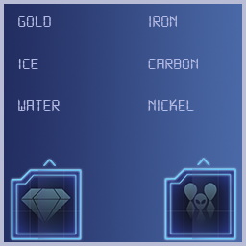
Player is shown how to close that screen
5%
12%
20%
35%
14%
14%
15
-3%
Tap anywhere away from the box to close it
60
100
100

Slide 16
Player is shown how to close that screen
5%
12%
20%
35%
Upcoming asteroids appear here
Tap them to see what they contain and when they will arrive
14%
14%
15
-3%
60
100
100

Slide 17
Explain the core player action
5%
12%
14%
20%
35%
14%
15
-3%
Decide which asteroids to use and which to leave to balance you wealth and population to generate faith
60
100
100

Slide 18

Show players how to use the store
5%
12%
14%
20%
35%
14%
Use your faith to purchase items from the store and customise your planet!
Tap the icon to see
60
100
100

